Slide 1
Experiences & outcomes of group psychotherapy as an antiretroviral adherence support intervention among young people failing ART at Newlands Clinic, Harare, Zimbabwe
Bahati Kasimonje, Tinei Shamu, Tinashe Mudzviti, Cleophas Chimbetete, Ruedi Luethy
BahatiK@newlandsclinic.org.zw

Slide 2
Potential Conflicts and Financial Disclosures
I have no actual or potential conflicts to declare in relation to this programme and presentation
Grant/Research support: None
Consulting: None

Slide 3
Background
Adherence to antiretroviral therapy (ART) is a major challenge faced by young people living with HIV (YPLHIV).
NC Viral Suppression Rates (<50cpml) – March 2018
Global trends reported by the World Health Organization show that compared to adults, YPLHIV have significantly lower rates of viral suppression and retention in care
Notes:
15 – 24 year olds have the lowest virological suppression rates

Slide 4
Background
There is limited evidence to inform strategies that promote adherence in this population
This study examined the experiences and outcomes of an adherence support strategy in young people (13 – 24 years old) presenting with virological failure at Newlands Clinic, Harare, Zimbabwe

Slide 5
Research Question
What are the experiences and virological outcomes of young people failing first line ART following an Enhanced Adherence Counselling Group Intervention (EACGI) preceded regimen switch?

Slide 6
Methods
Confirmed VF
EACGI
3
6
No EACGI
9
12
Notes:
Mixed methods study: both quantitative and qualitative data

Slide 7
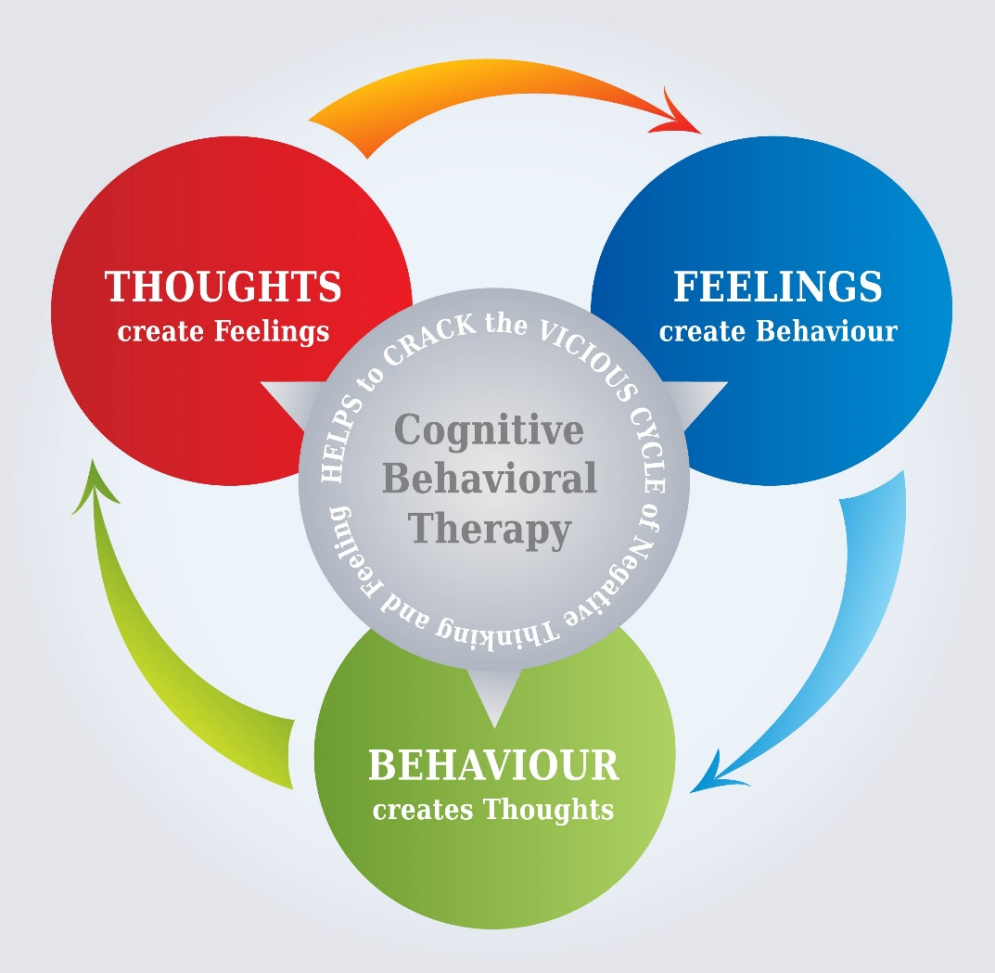
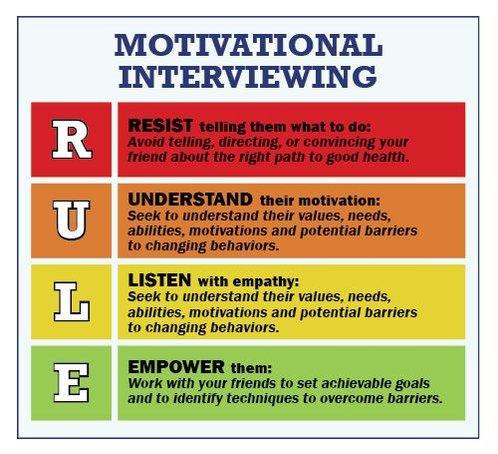
EACGI
EACGI was a 12 week curriculum-biopsychosocial topics
Utilises Phenomenological, Motivational Interviewing & CBT principles
1.5 hour long sessions
8-15 in a group within the same age ranges
1 year Follow up post EACGI during routine visits
Notes:
Phenomenological, how the adolescent is experiencing HIV adherence, HIV Management
Move from a state of indecision to making positive decisions and achieving goals
Resolving discrepancy

Slide 8
Results
Confirmed VF (59)
EACGI (37)
25 female
12 male
No EACGI
(22)
8 female
14 male

Slide 9
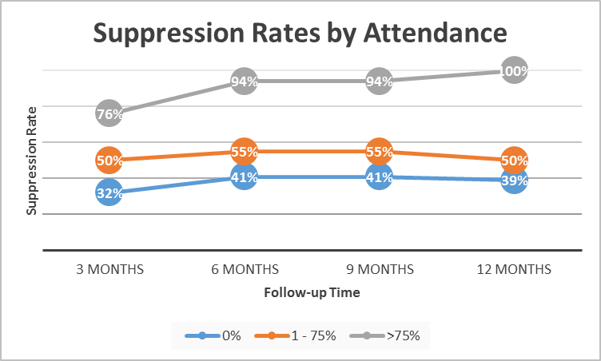
Virological Suppression Outcomes

Slide 10
Results
The main reasons for poor adherence among the 37 attendees were hopelessness, family dysfunction, lack of illness, an aversion to a daily routine attached to stigma, and medication side effects
“HIV is death, you are of no use, you are isolated, neglected and discriminated, there is no longer a future. It’s hard thinking that my entire life I am going to have to have to take medication. They remind you that you are worthless and sick but they do help the immune system.”
“Fear, skin disease, skinny body, desperation, death, home based care, sick bed, funeral, coffin”
“it is difficult to take pills everyday because we are young children, we forget, you also feel different, you feel ashamed”
“I was told my skin would improve, but now I am thinking of stopping because, my skin is not changing”

Slide 11
Conclusion
Patients who attended >75% EACGI had better second-line virological outcomes compared to those who attended less or none
EACGI is a promising tool for preparing young people for second line treatment, increasing the likelihood for improved adherence and treatment outcomes for second line therapy
This study was conducted using routinely collected data and therefore patients were not randomized into groups
A similar randomized study would provide objective assessment of the intervention's impact

Slide 12
Acknowledgements
Young people attending EACGI
The Ruedi Luethy Foundation
Newlands Clinic Staff

